Slide 1

co1 AT3 Technical presentation
S Lakshmi priya
192524284
GUIDED BY : R. Kesavan
CSA 0504
Data base management systems

Slide 2
ER diagram for an online library system

Slide 3
Introduction
An Online Library System is a digital application used to manage library activities efficiently.
It enables users to search, borrow, reserve, and return books online.
The system maintains records of books, members, librarians, transactions, reservations, and fines.
An Entity-Relationship (ER) Diagram is a graphical representation of the database structure.
It identifies the entities, their attributes, and the relationships between them.
The ER diagram helps in designing a well-organized and efficient database.

Slide 4
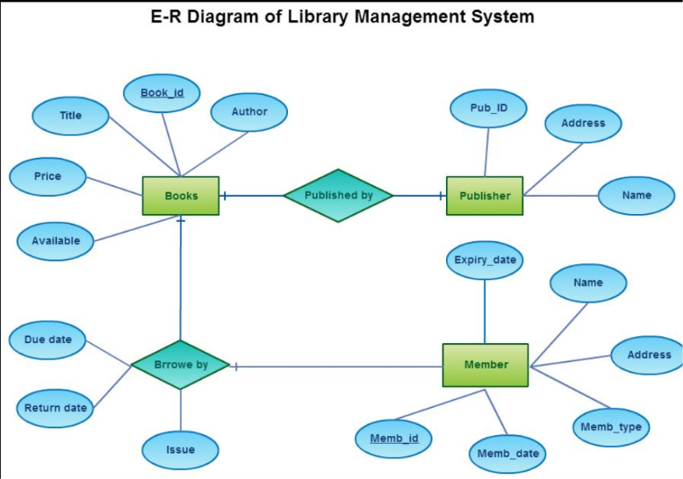
ER Diagaram

Slide 5
Conclusion
The ER diagram provides a clear and organized view of the Online Library System database.
It shows the relationships between books, members, librarians, borrowing, reservations, and fines.
It helps in designing an efficient and structured database.
It minimizes data redundancy and maintains data consistency.
It improves the accuracy of storing and retrieving library information.
It supports smooth management of book borrowing and return processes.

Slide 6
EER model demonstrating generalization and specialization with a university

Slide 7
introduction
The Enhanced Entity-Relationship (EER) Model is an extension of the ER model that represents more complex data relationships.
It introduces advanced concepts such as generalization, specialization, inheritance, and categorization. Generalization combines similar lower-level entities into a higher-level entity based on their common attributes.
Specialization divides a higher-level entity into lowerlevel entities based on their unique characteristics.

Slide 8
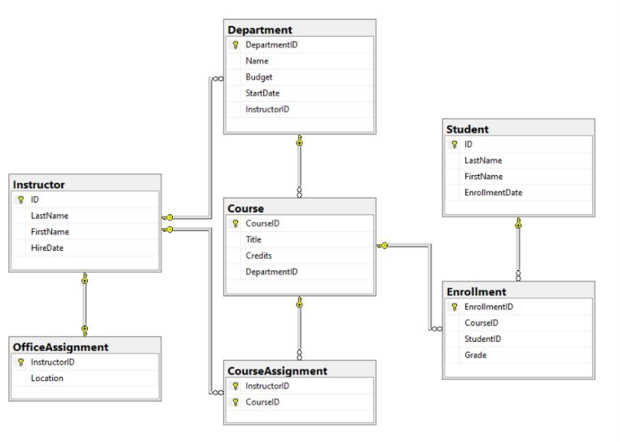
EER diagram for university management

Slide 9
conclusion
The EER model provides a more advanced and flexible database design than the basic ER model.
It uses generalization and specialization to represent real-world university entities effectively.
It allows common attributes to be inherited by specialized entities, reducing data redundancy.
It clearly distinguishes between Students, Faculty, and Staff while maintaining their relationship with the Person entity.
The model improves data organization, consistency, and accuracy. It simplifies database maintenance and future modifications.
It supports efficient storage and retrieval of university information.

Slide 10
Data independentand three –schema architecture

Slide 11
Introduction
Data Independence is the ability to modify the database structure without affecting application programs.
It ensures that changes made at one level of the database do not impact other levels.
There are two types of data independence: Physical Data Independence and Logical Data Independence.
Physical Data Independence allows changes in physical storage without affecting the logical structure of the database.
Logical Data Independence allows changes in the logical structure without affecting user applications or external views.
The Three-Schema Architecture is a database design framework that separates the database into three levels.

Slide 12
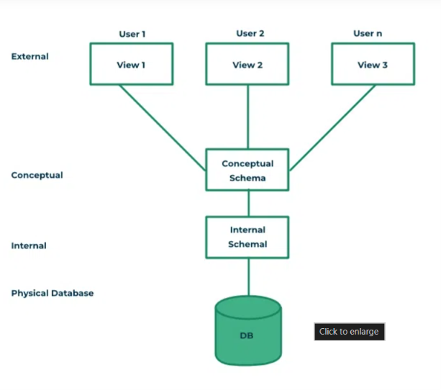
Data independence in dbms –three schema architecture

Slide 13
Conclusion
Data Independence is the ability to modify the database structure without affecting application programs.
It ensures that changes made at one level of the database do not impact other levels.
There are two types of data independence: Physical Data Independence and Logical Data Independence.
Physical Data Independence allows changes in physical storage without affecting the logical structure of the database.
Logical Data Independence allows changes in the logical structure without affecting user applications or external views.
The Three-Schema Architecture is a database design framework that separates the database into three levels.

Slide 14
Software components of a dbms

Slide 15
introduction
A Database Management System (DBMS) is software used to create, store, retrieve, and manage data efficiently.
A DBMS consists of several software components that work together to manage database operations.
These components help users interact with the database securely and efficiently. The Query Processor interprets and executes SQL queries submitted by users.
The Storage Manager manages the storage, retrieval, and updating of data in the database.
The Database Engine processes requests and ensures smooth execution of database operations.
The Transaction Manager maintains data consistency and handles concurrent transactions. The Recovery Manager restores the database after system failures and ensures data reliability.

Slide 16
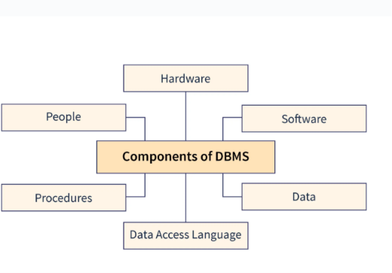
Software components of dbms

Slide 17
conclusion
The software components of a DBMS work together to manage database operations efficiently.
Each component performs a specific function, such as query processing, storage management, transaction control, and recovery.
These components ensure accurate storage, retrieval, and updating of data. The Transaction Manager maintains data consistency and supports concurrent access.
The Recovery Manager protects data and restores the database after failures. The Security Manager ensures that only authorized users can access the database.
The combined operation of these components improves database performance and reliability.
.

Slide 18
Comparison of strong and weak entities

Slide 19
Introduction
Strong and Weak Entities are important concepts in the Entity-Relationship (ER) model used in database design.
A Strong Entity is an entity that has its own primary key and can exist independently. A Weak Entity is an entity that does not have a primary key of its own and depends on a strong entity for its identification.
Strong entities are represented by a single rectangle in an ER diagram.
Weak entities are represented by a double rectangle in an ER diagram.
A weak entity is identified using a partial key along with the primary key of its related strong entity.
The relationship between a strong entity and a weak entity is called an identifying relationship, represented by a double diamond.
Strong entities can exist independently, whereas weak entities cannot exist without their corresponding strong entity.

Slide 20
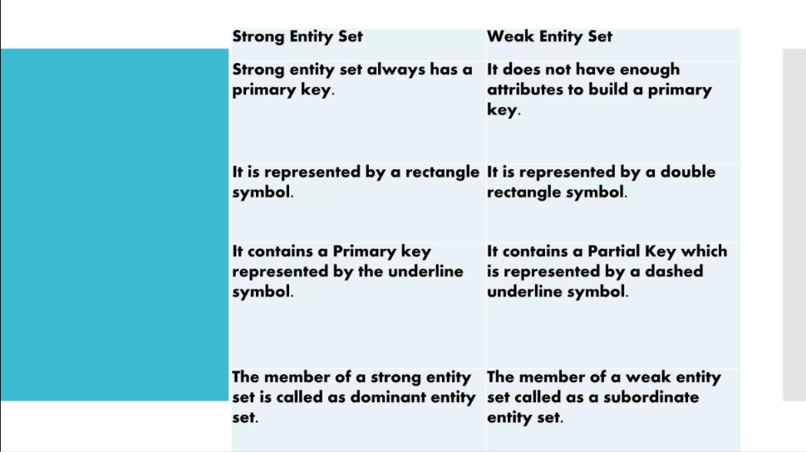
Comparison of strong and weak entities in ER modeling

Slide 21
conclusion
Strong entities have their own primary key and can exist independently. Weak entities depend on strong entities for their identification and existence.
Strong entities are identified by a single rectangle, while weak entities are represented by a double rectangle in an ER diagram.
Weak entities use a partial key together with the primary key of the related strong entity.
The identifying relationship ensures a proper connection between strong and weak entities.
Understanding the differences between strong and weak entities improves database design. It helps maintain data integrity and reduces redundancy.

Slide 22
THANK YOU

